Slide 1

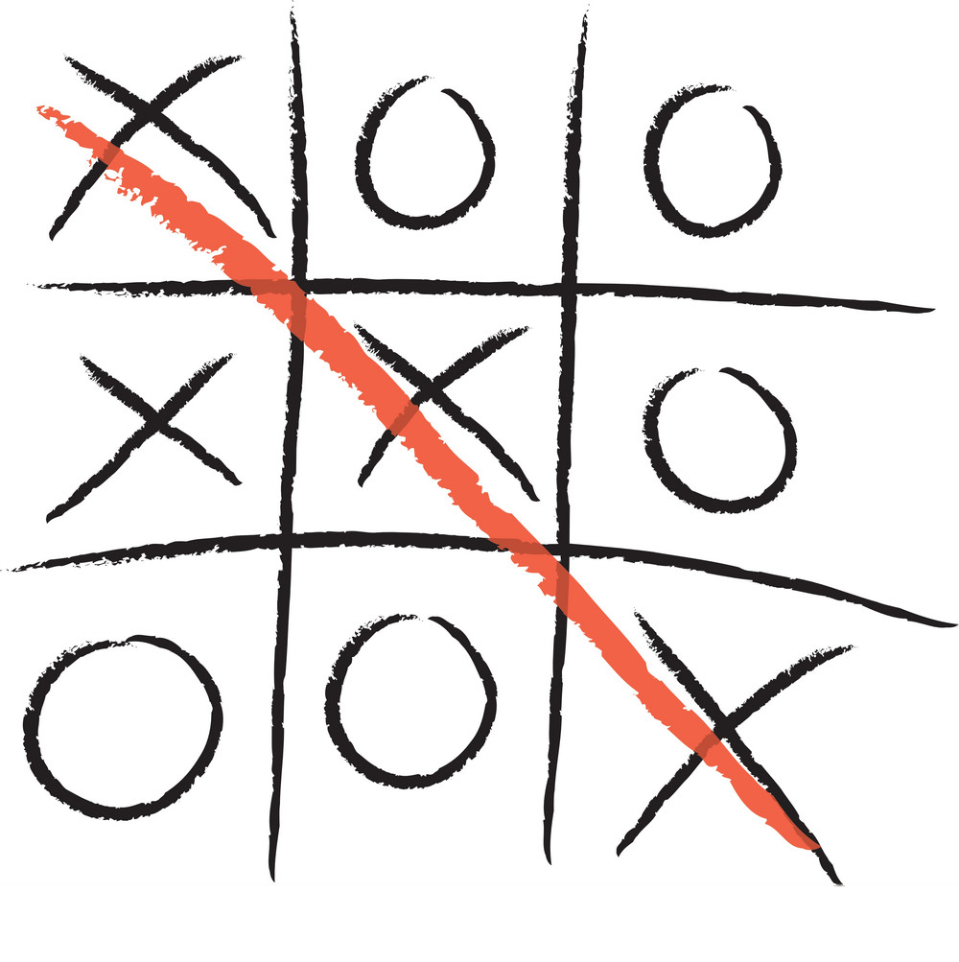
TIC TAC TOE
Alberico ivan 1756150
Pelle silvana 1756159

Slide 2
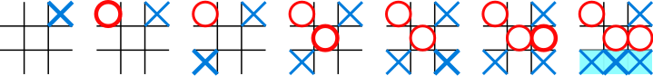
Tic-tac-toe (also known as noughts and crosses or Xs and Os) is a paper-and-pencil game for two players, X and O, who take turns marking the spaces in a 3×3 grid. The player who succeeds in placing three of their marks in a horizontal, vertical, or diagonal row wins the game.
The following example game is won by the first player, X:

Slide 3
GENERAL CONFIGURATION
Our project is about making a Tic Tac Toe game using digital logic design. The whole circuit is simulated in Proteus software.
The whole circuit is composed by 9 LEDs which represent the 9 boxes of the 3x3 grid. Push buttons are used to switch on the LEDs and each LED represents the moves of both two players, instead of using two LEDs to represent each box of the grid. For doing that we used bi-color LEDs. The final result will be shown by other two LEDs, one for win and one for draw. We also designed a stopwatch that displays the duration of each match.
LOGIC DEVELOPMENT
Inputs given by switches are recognized as either 1st or 2nd player move and they are stored in flip-flops. The LEDs are connected to the outputs of the flip-flops. Winning or drawing condition is also checked from the outputs of the flip-flops.

Slide 4
REQUIREMENTS
Red color denotes player1 and Green denotes player2.
A player should not be able to change other player’s move.
Player’s should have the ability to reset the game at any point.
Once a player wins, the “result” state should be locked.
If all the switches were pressed or if there is a draw situation , a separate LED should glow.

Slide 5
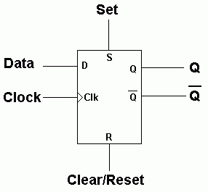
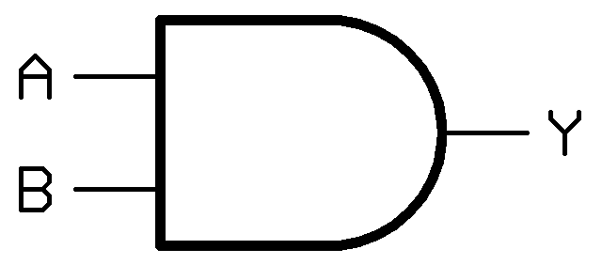
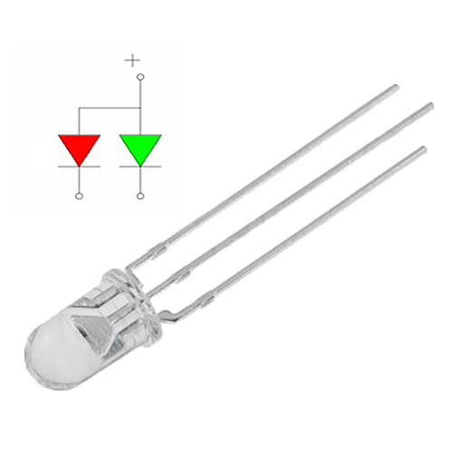
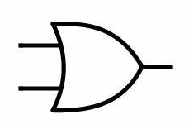

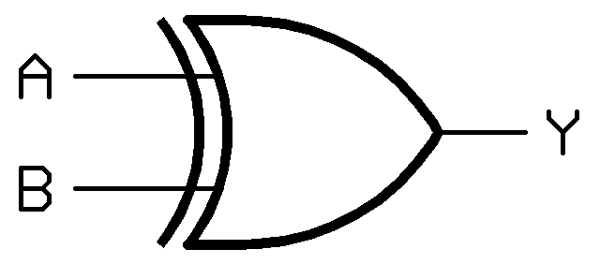
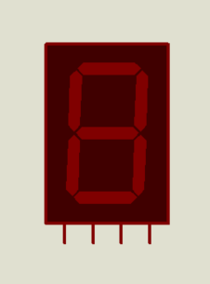
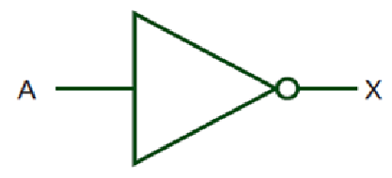
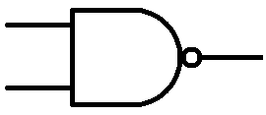
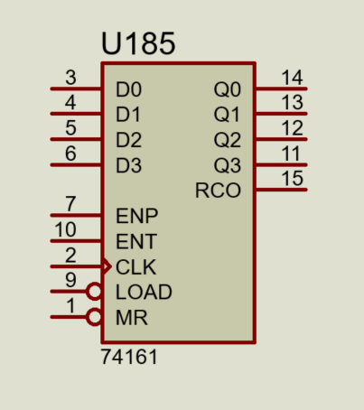
Which are the logical elements we used
AND gates
D-flip flops with set and reset
Bi-colour LEDs
OR gates
Single-colour LEDs
Buttons
XOR gates
7-segment display
NOT gates (inverters)
NAND gates
4-bit counters

Slide 6
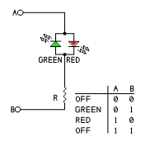
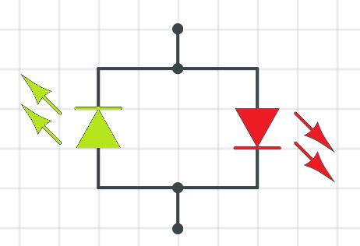
BI-COLOR LED
A Bi-color LED allows two colors to be switched on (red and green) in a single LED while only having two pins (cathode and anode). The color of the LED depends on the polarity of the connection, and it allows one color at a time.
On the inside there are two LED's in parallel to each other, one forward and one reverse. The LED will light up either green or red according to the verse of flowing of the current.

Slide 7
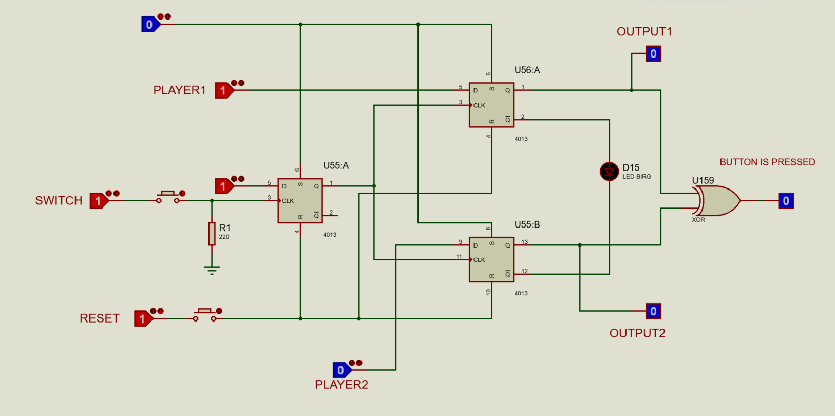
BUTTON CONFIGURATION
Before pressing the button
PROTEUS SIMULATION

Slide 8
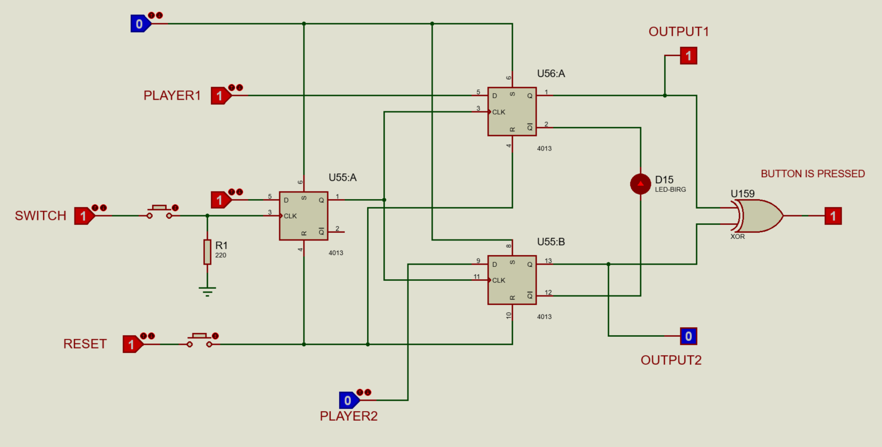
After the button has been pressed
PROTEUS SIMULATION

Slide 9
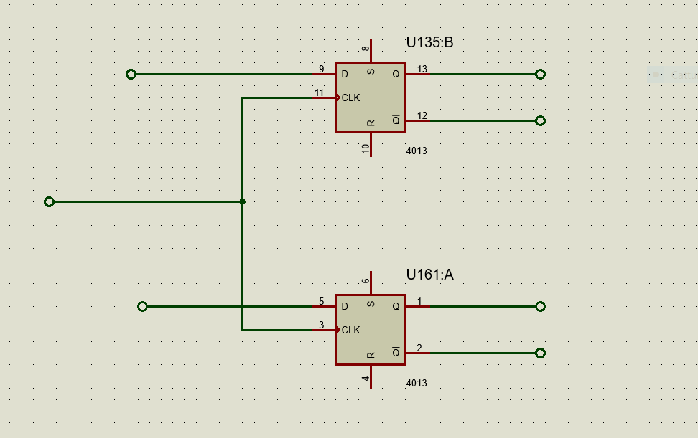
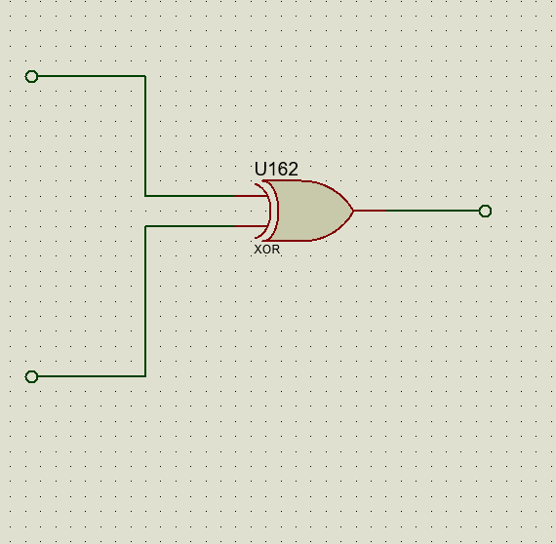
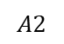
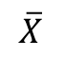
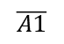


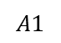

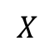


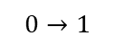
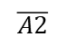
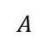
$$X$$
$$A1$$
$$\overline{A1}$$
$$0→1$$
$$A$$
$$\overline{X}$$
$$A2$$
$$\overline{A2}$$
The inputs of the two D-flip flops are two variables PLAYER1 and PLAYER2. However we have that when player1 is playing, player2 is not, so we can define a new variable X such that
$$X=PLAYER1$$
$$\overline{X}=\text{​}PLAYER2$$
We know that the state equation for a D flip flop is
$$Q(t+1)=D$$
In this case for the 2 flip flops we have that
$$\begin{matrix}A1(t+1)=X \\ A2(t+1)=\overline{X}\end{matrix}$$
while the output equation for A is
$$A=A1⊕A2$$

Slide 10
STATE TABLE
Present State |  | Input | Next State |  | Output
A1 | A2 | X | A1 | A2 | A
0 | 0 | 0 | 0 | 1 | 1
0 | 0 | 1 | 1 | 0 | 1
0 | 1 | 0 | 0 | 1 | 1
0 | 1 | 1 | 1 | 0 | 1
1 | 0 | 0 | 0 | 1 | 1
1 | 0 | 1 | 1 | 0 | 1
1 | 1 | 0 | 0 | 1 | 1
1 | 1 | 1 | 1 | 0 | 1

Slide 11
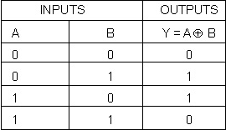
From the state table we can notice that the output A is always equal to 1.
From the XOR truth table we know that the output of a XOR gate is equal to 0 if the inputs have the same value, and is equal to 1 if the inputs have opposite values.
XOR
Present State |  | Input | Next State |  | Output
A1 | A2 | X | A1 | A2 | A
0 | 0 | 0 | 0 | 1 | 1
0 | 0 | 1 | 1 | 0 | 1
0 | 1 | 0 | 0 | 1 | 1
0 | 1 | 1 | 1 | 0 | 1
1 | 0 | 0 | 0 | 1 | 1
1 | 0 | 1 | 1 | 0 | 1
1 | 1 | 0 | 0 | 1 | 1
1 | 1 | 1 | 1 | 0 | 1
The fact that A is always equal to 1 means that a button has been pressed, no matter if it was player1’s turn or player2’s turn.

Slide 12
BUBBLE DIAGRAM
0/1
0/1
00
01
0/1
Present State |  | Input | Next State |  | Output
A1 | A2 | X | A1 | A2 | A
0 | 0 | 0 | 0 | 1 | 1
0 | 0 | 1 | 1 | 0 | 1
0 | 1 | 0 | 0 | 1 | 1
0 | 1 | 1 | 1 | 0 | 1
1 | 0 | 0 | 0 | 1 | 1
1 | 0 | 1 | 1 | 0 | 1
1 | 1 | 0 | 0 | 1 | 1
1 | 1 | 1 | 1 | 0 | 1
1/1
0/1
1/1
1/1
11
10
1/1

Slide 13




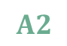
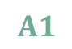
When the game begins, the first move is up to player1 so we have that =1 and = 0. A1 and A2 are equal to 0 at the beginning.
$$X$$
$$\overline{X}$$
Clock
1
$$X$$
0
$$A1$$
(positive edge-triggered flip flops)
Clock
1
$$\overline{X}$$
0
$$A2$$
0

Slide 14
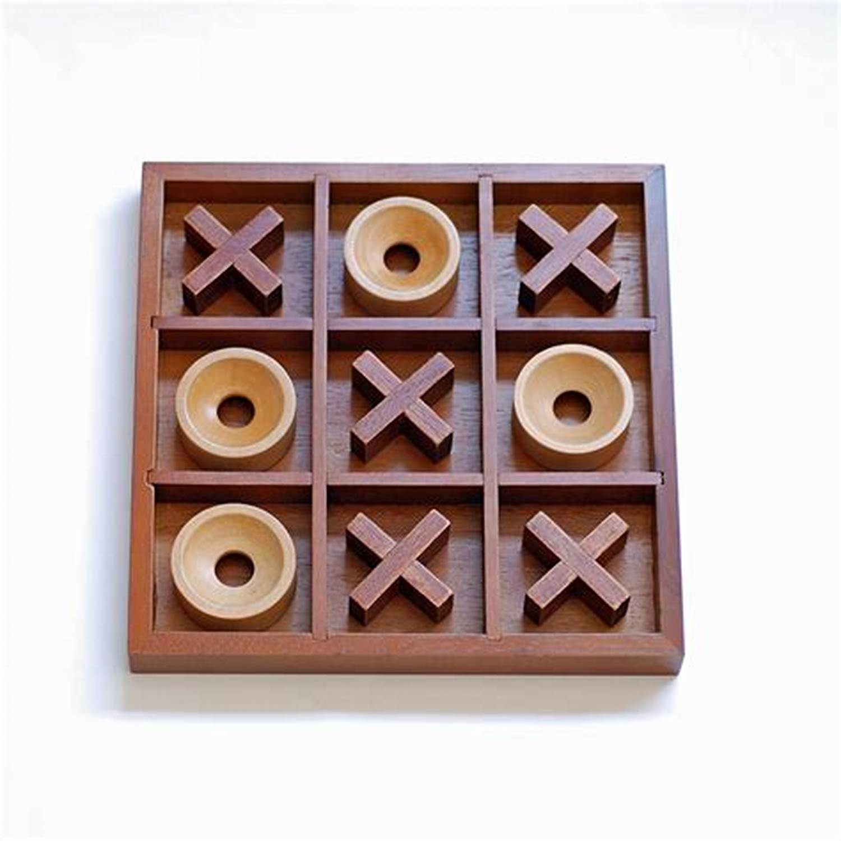
PLAYER’S CONFIGURATION
When the game starts, the first move is up to player1. The two variables PLAYER1 and PLAYER2 are the inputs of the two flip flops of each button configuration, as we have seen before.
However when PLAYER1 variable is high, PLAYER2 is low and viceversa. Each time a button is pressed, there is a switch between the values of these two variables: this means that when a player makes a move, it is up to the other player to make the next step.
Since we have 9 buttons, we should make a 9 variable K-map to find the function that regulates the process. In order to simplify the whole thing, we can also consider less variables, since the process is the same even if we consider a different number of buttons in the game.

Slide 15
Let’s suppose we have only 4 buttons
TRUTH TABLE
A | B | C | D | PLAYER2 | PLAYER1
0 | 0 | 0 | 0 | 0 | 1
0 | 0 | 0 | 1 | 1 | 0
0 | 0 | 1 | 0 | 1 | 0
0 | 0 | 1 | 1 | 0 | 1
0 | 1 | 0 | 0 | 1 | 0
0 | 1 | 0 | 1 | 0 | 1
0 | 1 | 1 | 0 | 0 | 1
0 | 1 | 1 | 1 | 1 | 0
1 | 0 | 0 | 0 | 1 | 0
1 | 0 | 0 | 1 | 0 | 1
1 | 0 | 1 | 0 | 0 | 1
1 | 0 | 1 | 1 | 1 | 0
1 | 1 | 0 | 0 | 0 | 1
1 | 1 | 0 | 1 | 1 | 0
1 | 1 | 1 | 0 | 1 | 0
1 | 1 | 1 | 1 | 0 | 1

Slide 16




 | 00 | 01 | 11 | 10
00 |  | 1 |  | 1
01 | 1 |  | 1
11 |  | 1 |  | 1
10 | 1 |  | 1
C D
4 VARIABLE K-MAP
A B
$$PLAYER2=\overline{A}\overline{B}\overline{C}D+\overline{A}\overline{B}C\overline{D}+\overline{A}B\overline{C}\overline{D}+\overline{A}BCD+AB\overline{C}D+ABC\overline{D}+A\overline{B}\overline{C}\overline{D}+A\overline{B}CD$$
$$\left.=\overline{A}\overline{B}(\overline{C}D+C\overline{D})+\overline{A}B(CD+\overline{C}\overline{D})+AB(\overline{C}D+C\overline{D})+A\overline{B}(\overline{C}\overline{D}+CD\right)$$
$$\left.=(C⊕D)(\overline{A⊕B})+(A⊕B)(\overline{C⊕D}\right)$$
$$=(A⊕B)⊕(C⊕D)\text{​}$$
$$=A⊕B⊕C⊕D$$

Slide 17
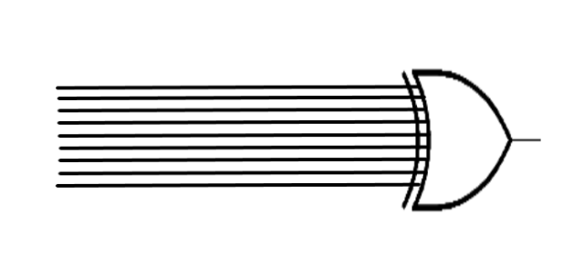
Now, considering all the 9 buttons we have:
PLAYER 2 $=A⊕B⊕C⊕D⊕E⊕F⊕G⊕H⊕I$
This means that if any odd number of push buttons are pressed, the output of the final XOR gate will be 1, and for even number of push buttons pressed the output will be 0.
A
B
C
D
PLAYER 2
E
F
G
H
I

Slide 18
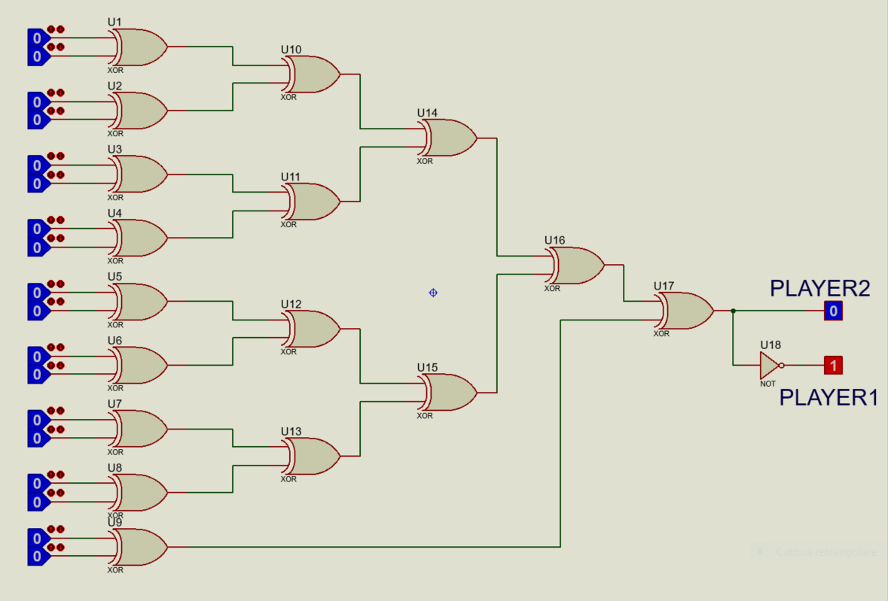
PROTEUS SIMULATION

Slide 19
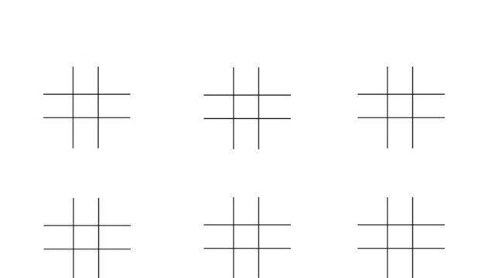
WINNING CONDITIONS
In Tic Tac Toe game a winner is found if one of these following 8 combinations is verified:

Slide 20
In terms of variables it means that there is a winner as soon as one of the following values becomes high: ABC, DEF, GHI, ADG, BEH, CFI, AEI, CEG.
So we connect these values with 3-input-AND gates that become high when all the three values connected are high. Then we connect all the eight gates with an OR gate, this because a winner is found when at least one of the previous gates becomes high.
A
C
B
D
E
F
The function Y that states if a winner is found or not, is defined as follows:
G
H
I
$$Y=ABC+DEF+GHI+ADG+BEH+CFI+AEI+CEG$$

Slide 21
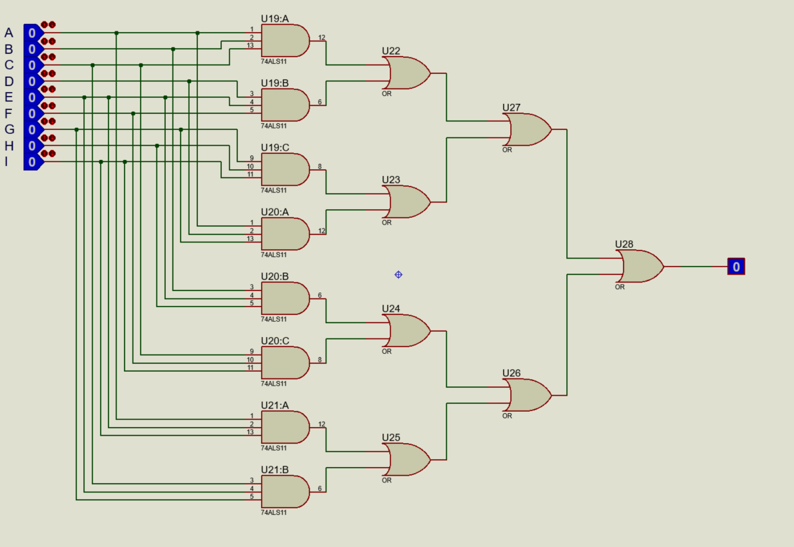
PROTEUS SIMULATION

Slide 22
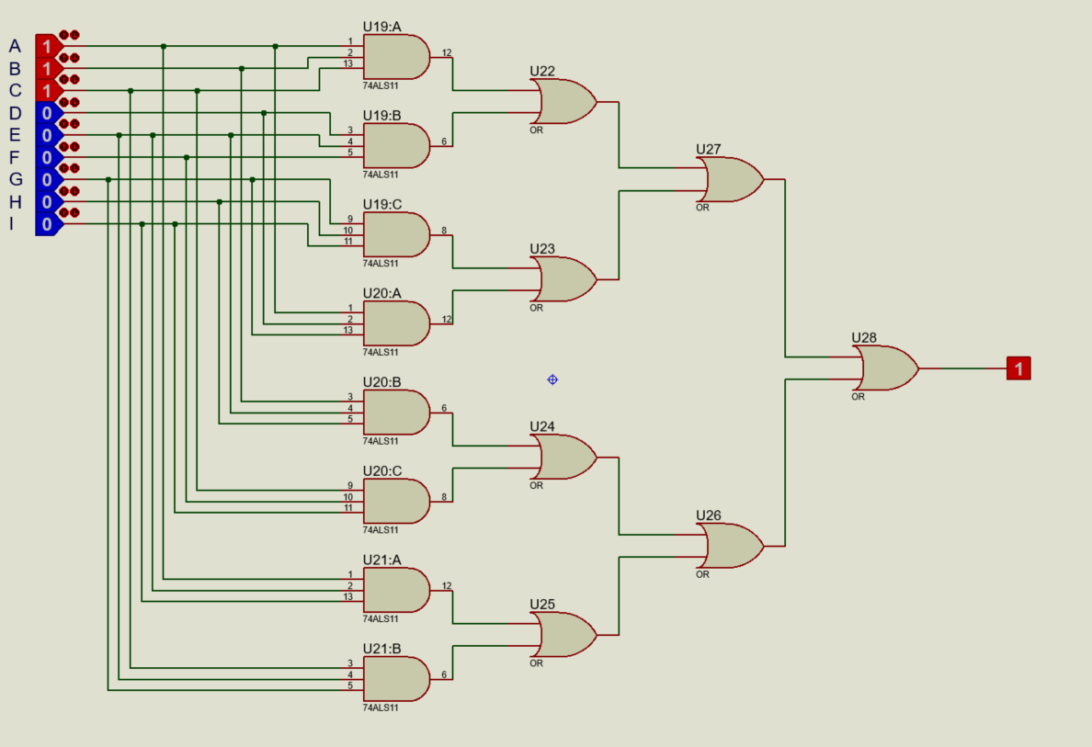
When a winner is found
PROTEUS SIMULATION

Slide 23
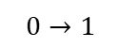
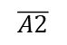
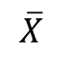
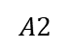
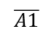
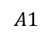
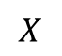
However in the circuit design we need to separate whether the game is won by player1 or player2.
$$X$$
$$A1$$
$$\overline{A1}$$
BUTTON A
$$0→1$$
$$\overline{X}$$
$$A2$$
$$\overline{A2}$$
To do that we still need the function defined before but with some considerations. Let’s consider the button configuration seen before. To define WIN1 (the variable that states if player1 has won or not) we use the outputs of the first flipflops of the buttons configuration, instead with WIN2 we use the outputs of the second flipflops. Hence:
$$WIN1=A1+B1+C1+D1+E1+F1+G1+H1+I1$$
$$WIN2=A2+B2+C2+D2+E2+F2+G2+H2+I2$$
Then we connect these two variables, followed both by a NOT gate, to the pins of the winning LED.

Slide 24
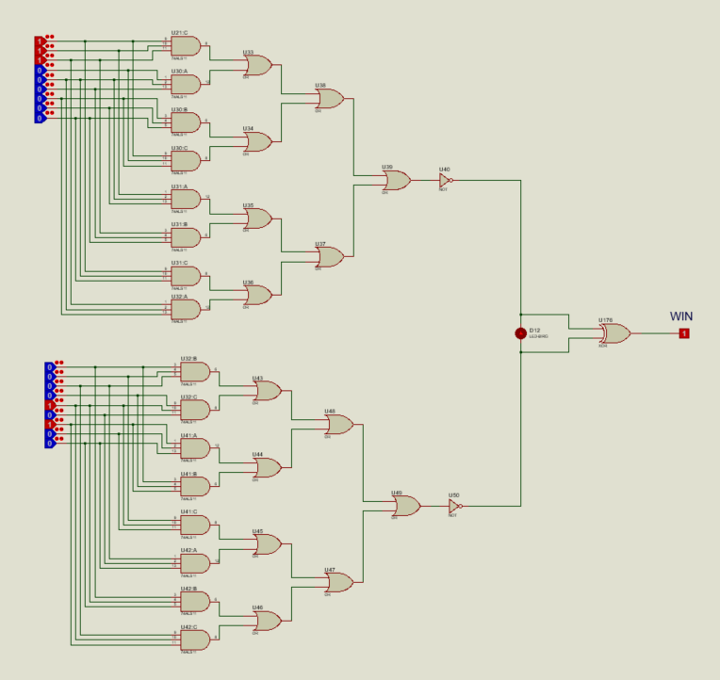
PROTEUS SIMULATION

Slide 25
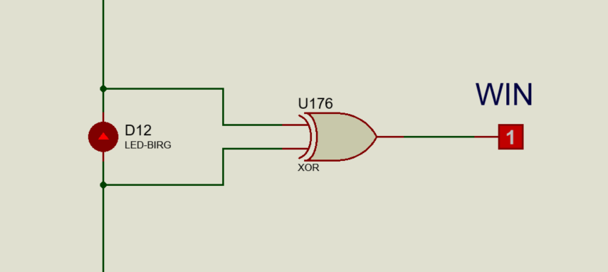

PROTEUS SIMULATION
$$WIN=\overline{WIN1}⊕\overline{WIN2}$$
Let’s define a new variable WIN that indicates when there is a winner. In fact that XOR gate is equal to 1 only when one of the two players has won the game. Let’s suppose player1 is the winner, so we have that WIN1=1 and WIN2=0 and therefore WIN=1.
Now it is very important that, after the winner is found, the game must be ended right away. That means, when a player wins, the remaining unpressed buttons should be blocked by modifying the system.

Slide 26
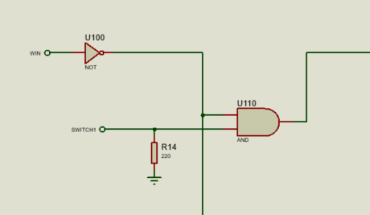
Once we found a winner, we have to prevent the other remaining switches from making any changes in the circuit. For doing this, an additional AND gate should be used right after each switch of the circuit. The AND gate take as inputs the input coming from the switch and the winning input with a NOT gate: it means that as long as a winner is not found the 2 inputs of the AND gates will be high and so the output. This will let the player to light the LEDs.
PROTEUS SIMULATION

Slide 27
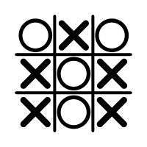
DRAW CONDITION
If all the buttons are pressed and a winner is not found we have a draw. A draw condition is shown above:
We use 3-input AND gates to take the inputs of the buttons, while another AND gate takes the input from the winning LED (the output of this gate will be high if a winner is not found, since both pins of the winning LED are high in this case). Then we use an additional AND gate that we connect to a single LED, that will light up if the draw condition is verified. In fact, if the match is draw the output of both AND gate will be high. Hence the output of the final AND gate will be high and the draw LED will light up.

Slide 28
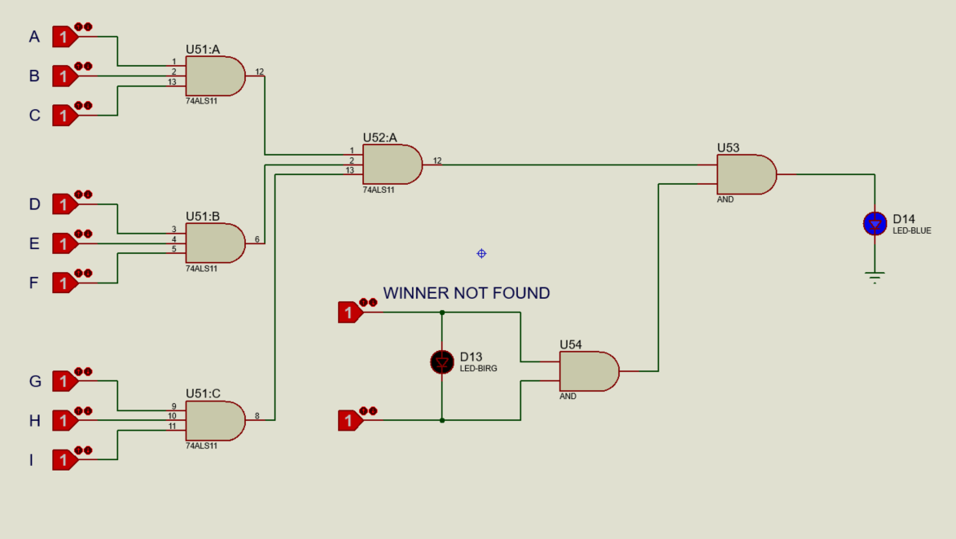
PROTEUS SIMULATION

Slide 29
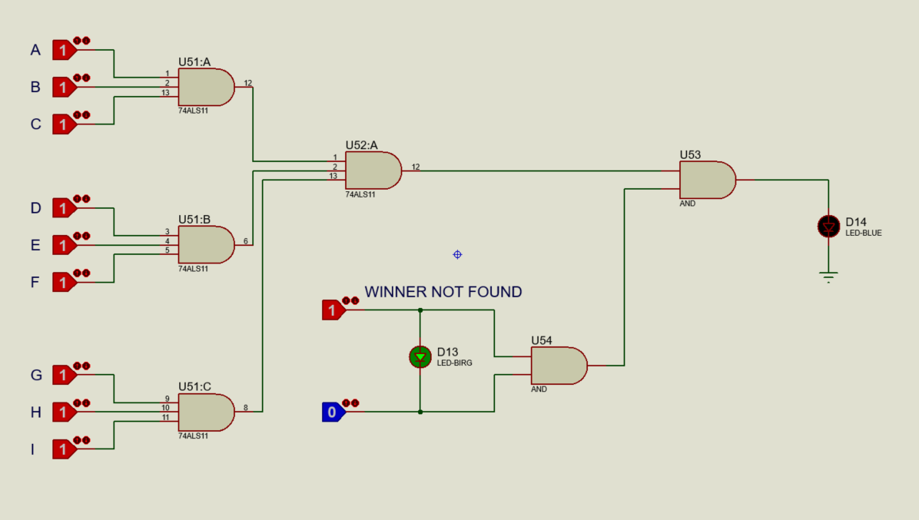
PROTEUS SIMULATION

Slide 30

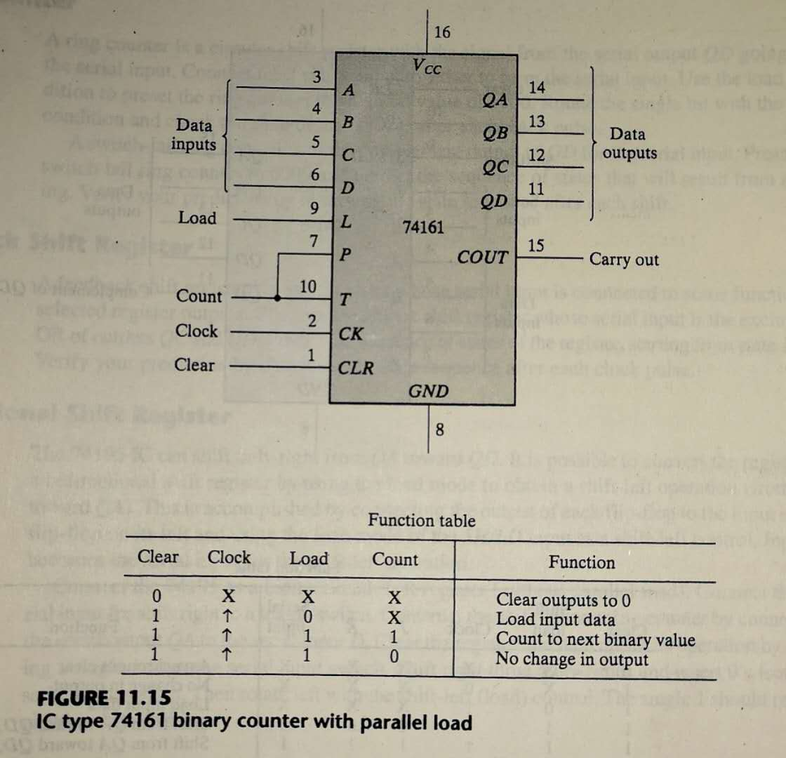
STOPWATCH FOR THE DURATION OF A MATCH
We also designed a stopwatch to calculate the duration of each match.
To do that we used 74161 4-bit binary counters.
The function table is similar to the one we saw in class with the exception that the input in the 74161 is enabled when equal to 0. So to load the input data, the clear input must be equal to 1 and the load input must be equal to 0. For this reason, when we want to start over, we connect a NAND gate to the load rather than an AND gate.
The internal flip-flops trigger on the positive transition of the clock pulse.
The circuit functions as a counter when the load input is equal to 1 and both counts inputs P and T are equal to 1.

Slide 31
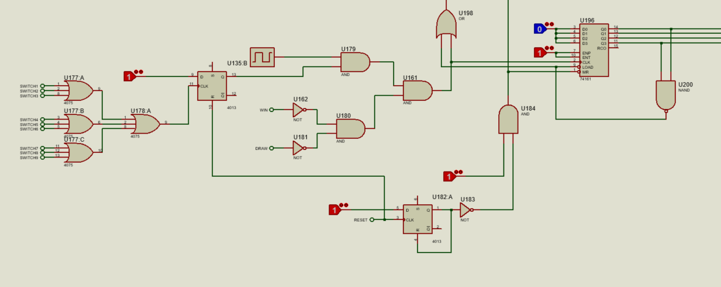
The stop-watch starts counting when one of the 9 buttons is pressed, and stops when we have either a winner or a draw condition. When we press the reset button the stopwatch should be reinitialized.

Slide 32
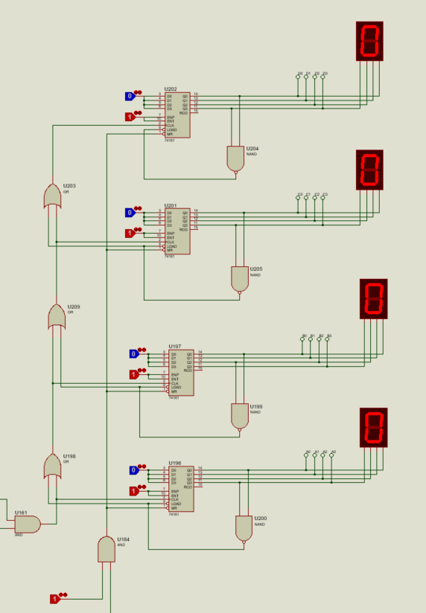
The results of the counters are shown in 7-segment displays.
Starting from the bottom, the first two displays represent the seconds, while the others the minutes.
The first counter counts up to 9. When it reaches the value of 9, the NAND gate value is 0, so the inputs are loaded and the counter starts counting again from 0. While doing so the clock of the other counter is triggered. So the second counter counts each time the first counter goes from 9 to 0.
The second counter counts up to 5. In the moment it displays the value 5 and the first counter goes from 9 to 0, they are both resetted to 0, while the third counter is triggered and it displays the value of 1. That means that one minute has passed.
The maximal value the stopwatch can reach is 99 minutes and 59 seconds. Than it restarts from 00:00.

Slide 33



Slide 34

WHOLE LOGICAL CIRCUIT
PROTEUS SIMULATION

Slide 35

PROTEUS SIMULATION

Slide 36
Thanks for the attention!

